Slide 1
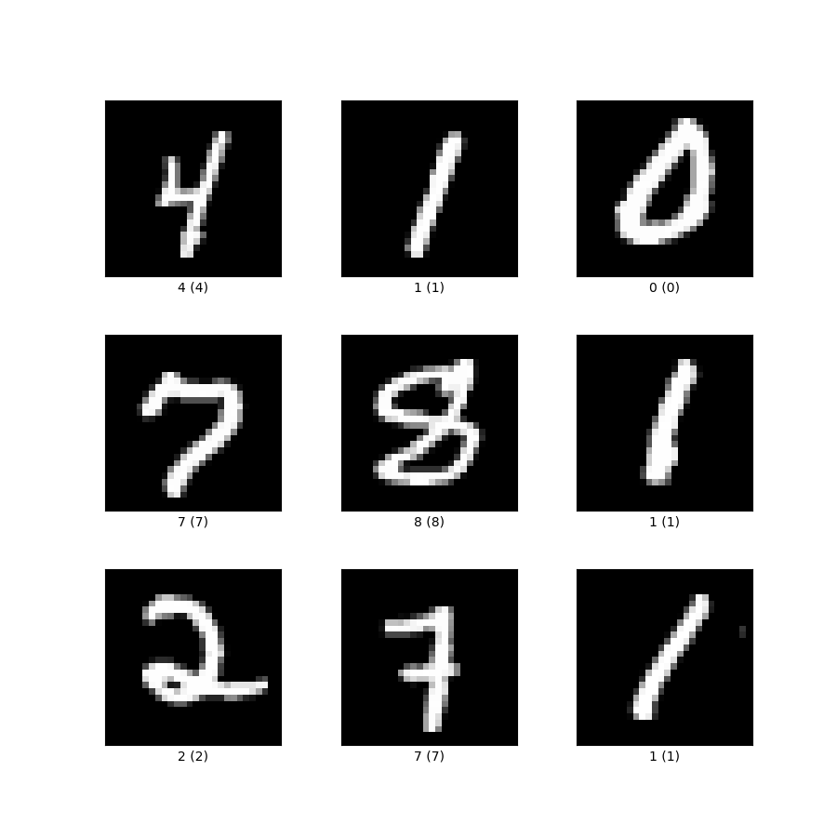
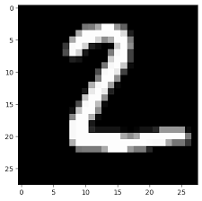


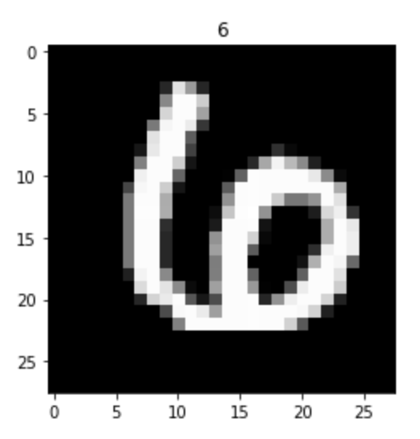

MNIST Workshop
-Presented by the WEAP Education Team

Slide 2


AGENDA
01
The Perceptron
02
Multi-Layer Perceptron and MNIST Classification with MLP
03
Convolutional Neural Networks

Slide 3
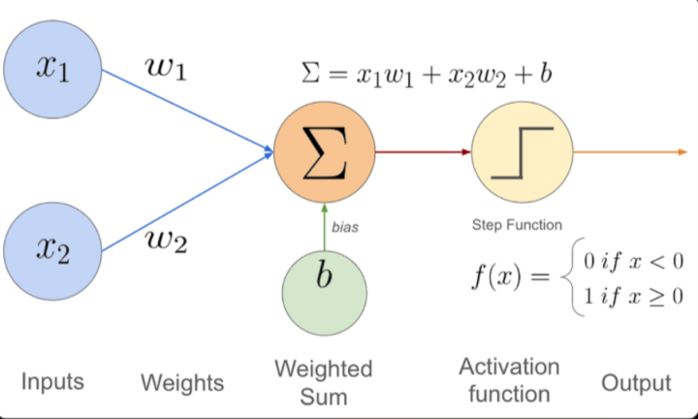
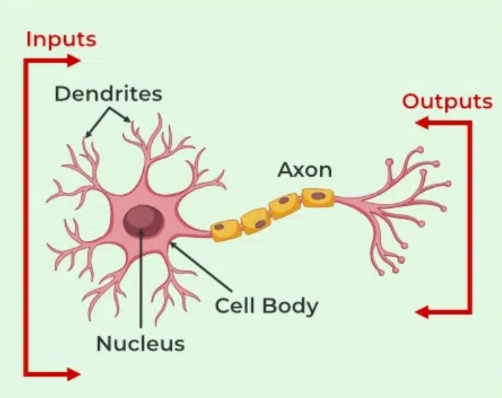
The Perceptron
The Perceptron is the simplest form of artificial neural network, used for binary classification
The Perceptron was designed on the basis of how biological neurons function, which results in a decision-making process.

Slide 4
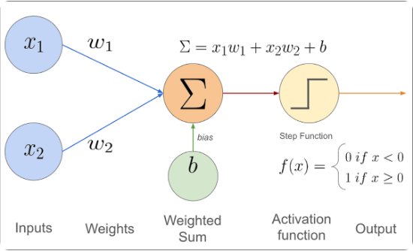
What is a Perceptron?
The perceptron is the simplest model of a biological neuron.
Inputs (x): Information entering the neuron.
Weights (w): The "importance" of each input.
Bias (b): A threshold to trigger activation.
Output (y): The final decision (0 or 1).
It draws a linear boundary to separate data.

Slide 5
How does the Perceptron Works ?
x₃
w₃
w₁
Activation function
x₂
Result
w₂
constant
x₁
Weights
Inputs
b
Bias

Slide 6










How it Learns (The Loop)
1. Forward
2. Loss
3. Zero Grad
Make a prediction
Check the error
Clear old history
4. Backward
5. Step
6. Repeat
Calculate gradients
Update weights
Do it 100x

Slide 7
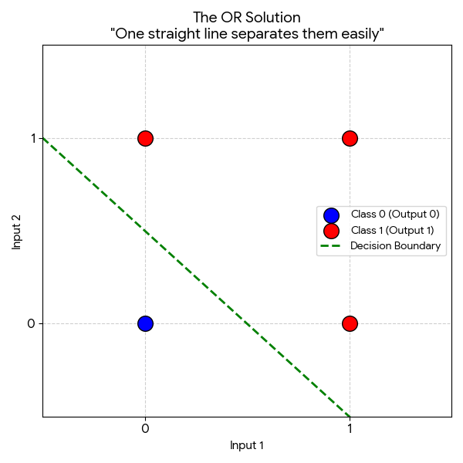
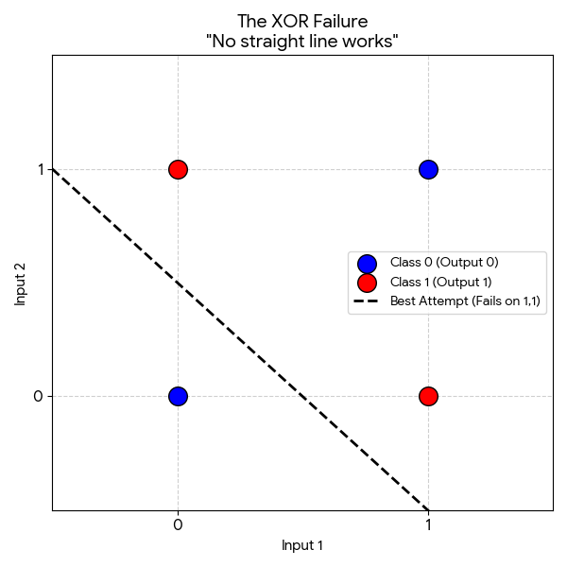

Slide 8


The Failure
0.25
Stuck Loss
Linearity Limit
The model stops learning. The loss refuses to go lower.
You cannot separate the red and blue dots with one straight stick.
Why? A single perceptron is a linear classifier. It cannot draw a curve or two lines to separate the XOR pattern.

Slide 9
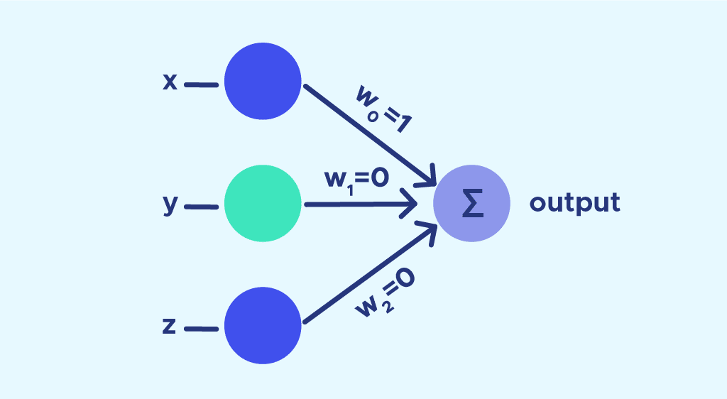
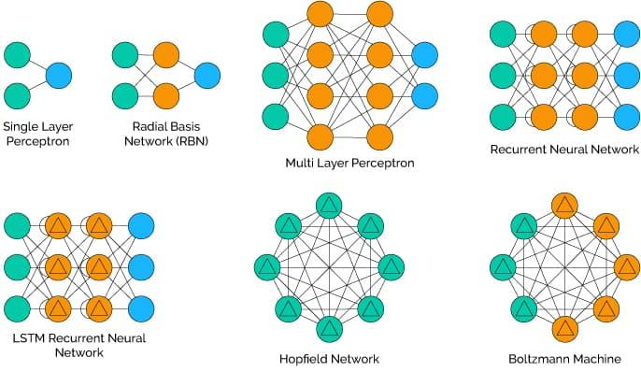
What is an MLP?
Multiple Layered Perceptron
Overcomes the limitations of a single perceptron
Stacks multiple layers and introduces non-linearity through activation functions
Swiss-Army Knife of Deep Learning
Highly effective general-purpose models
Works best with tabular data
Used as parts of larger neural network architectures
Restrictions
Computationally inefficient due to every layer being fully-connected
Rigid architecture makes it bad for video and audio inputs of varying lengths. Also loses spatial/temporal structure

Slide 10
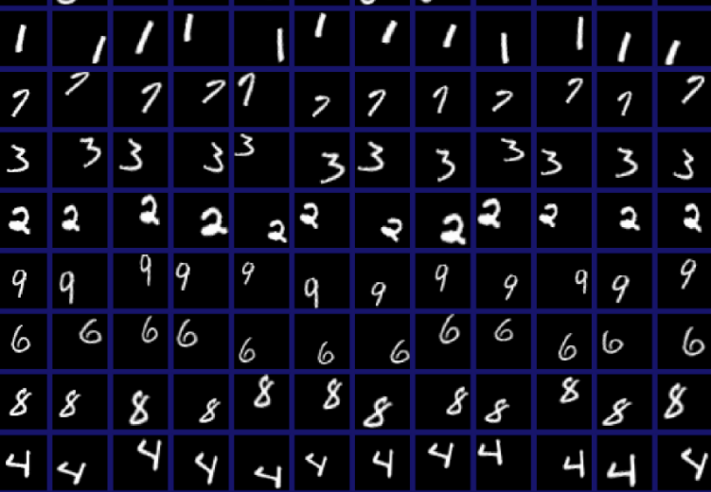
MNIST Classification

Slide 11
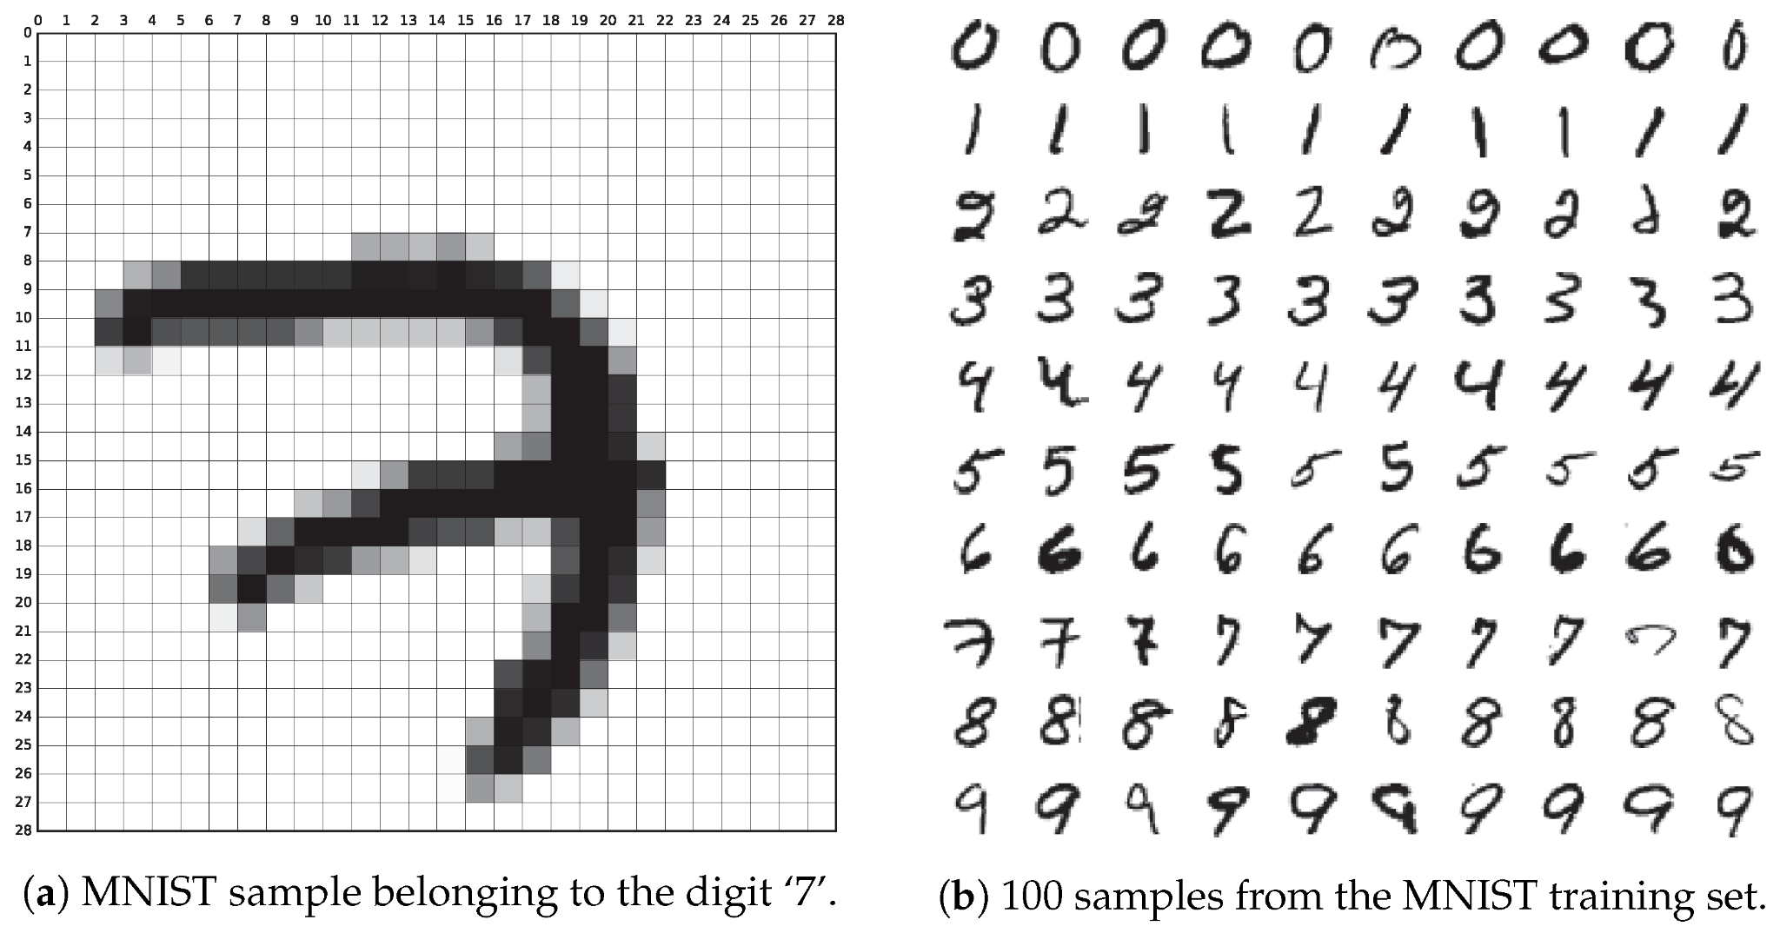
What is MNIST
01
Dataset
A collection of handwritten digits from 0-9
60,000 training images and 10,000 testing images, each 28x28 pixels in grayscale.
02
“Hello World”
Used as the introductory dataset for computer vision and machine learning.
Availability makes it perfect as an introduction to image processing and deep learning
03
Our Plan
Build a neural network built off of perceptrons and trained on the MNIST dataset to identify digits

Slide 12
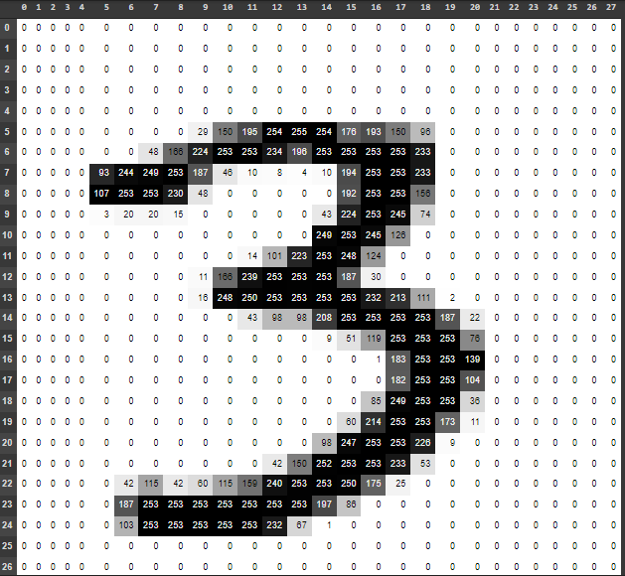
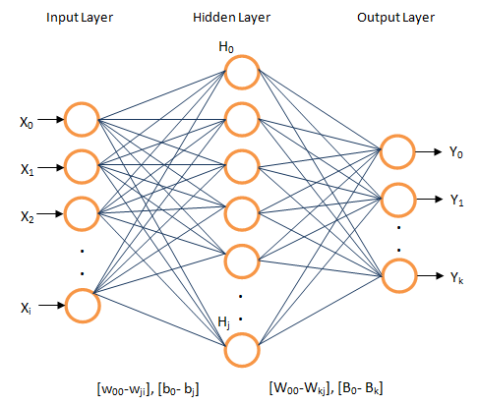
Steps
01
Working with the Dataset
Explanation of MNIST + why and how to use PyTorch provided tools for this task
02
Building a Basic MLP Model
Tutorial on using PyTorch library to construct a neural network
03
Training the Model
Describe basic training loop used to train and refine a model

Slide 13
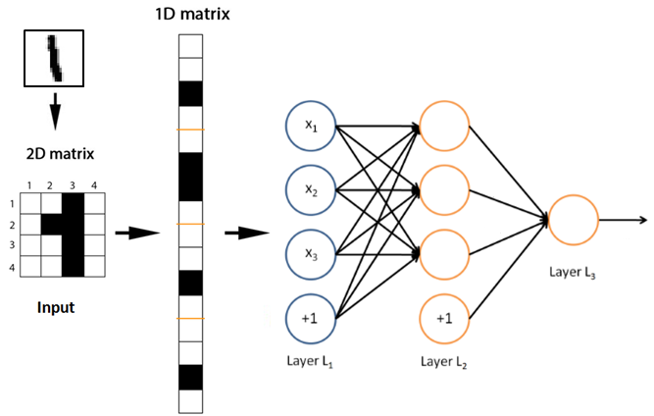
Understanding our Dataset
The images are stored as PIL objects
Neural networks expect tensor objects to work with
We want to transform our dataset so that we can properly work with it
Conversion Path:
PIL Image
NumPy Array: shape (28, 28, 1), dtype uint8, values [0-255]
NumPy Array: shape (1, 28, 28), dtype uint8, values [0-255]
PyTorch Tensor: shape (1, 28, 28), dtype float32
Normalize color values form [0-255] -> [0-1]

Slide 14

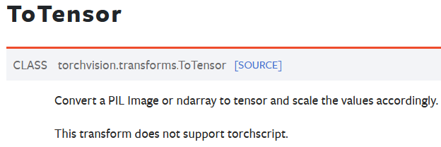
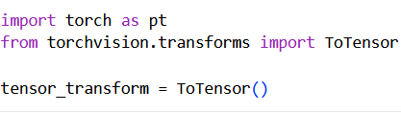
PyTorch Framework
Solution:
PyTorch framework
Torchvision library
Utilize ToTensor function
Import torch (torchvision included)
From torchvision import ToTensor
Instantiate ToTensor

Slide 15
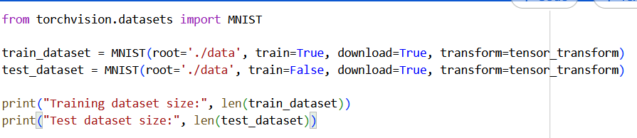
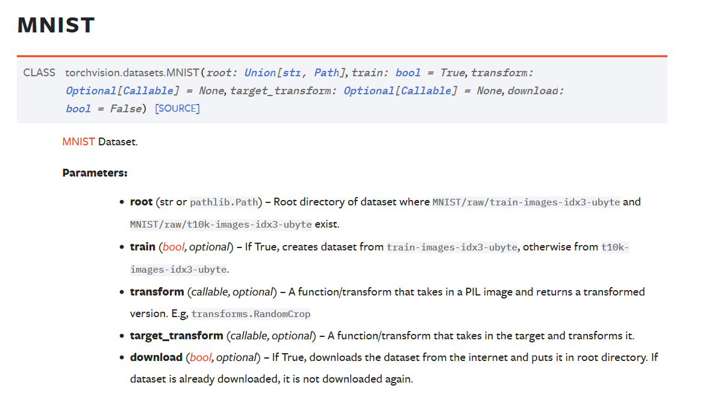
Importing the Dataset
MNIST DATASET ALSO INCLUDED IN TORCHVISION LIBRARY
NEED TO CREATE TWO DATASETS: - ONE TO TRAIN MODEL
- ONE TO TEST MODEL
Free Parameter:
root= ‘./data’

Slide 16
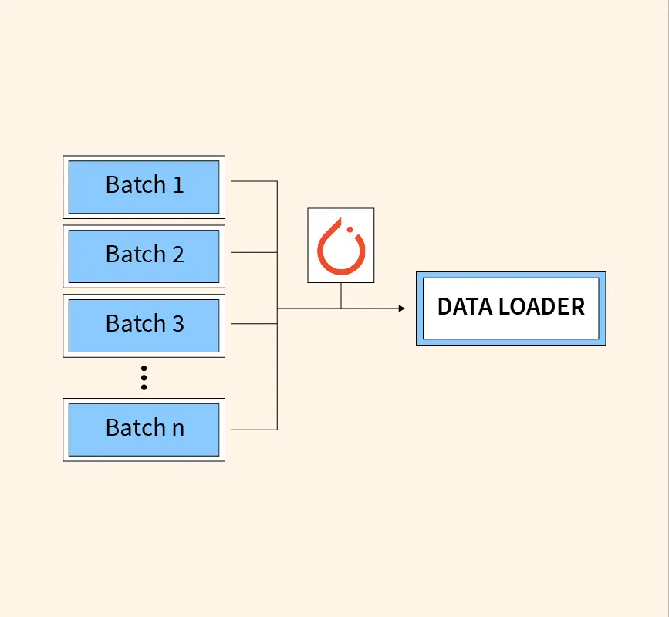
About Data Loaders
01
Batching
Refers to the process of breaking the dataset into smaller chunks that are fed to the model.
Leverages hardware capabilities for increased efficiency and reduces memory footprint (whole dataset not loaded into RAM)
02
Shuffling
Shuffles the data order so that the model encounters more combinations thus stopping overfitting.
Through this exposure, forces the model to learn more generalizable features

Slide 17
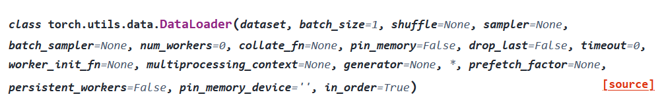
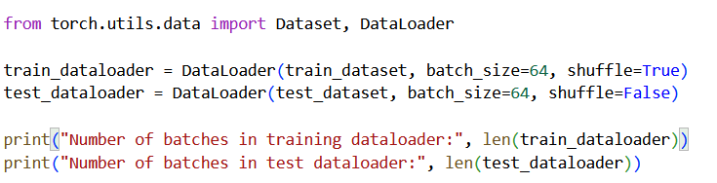
DATALOADER

Slide 18
Neural Network Steps
01
Setting up the NN
In our NN class we need to define two functions:
init(self) - What is the neural network created with -> Define the layers
forward(self, x) - The process of the data being passed through the neural network
02
Loss and Optimizer
03
Training the Model

Slide 19
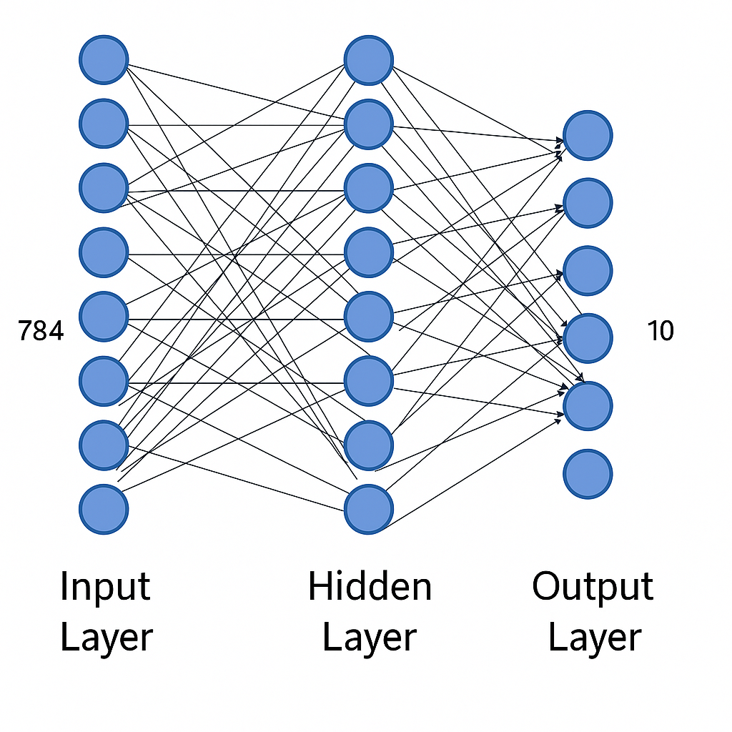
What are the Layers of a Neural Network
01
Input Layer
Where the raw data is received. No calculations are done in this layer, the data is simply passed on
02
Hidden Layers
Where the actual learning is done. Each hidden layer neuron performs a computation and applies an activation function before passing it on to potentially more layers
03
Output Layer
Where the final output is displayed. Each neuron displays the probability of the image being that specific digit with the highest percentage neuron being chosen

Slide 20
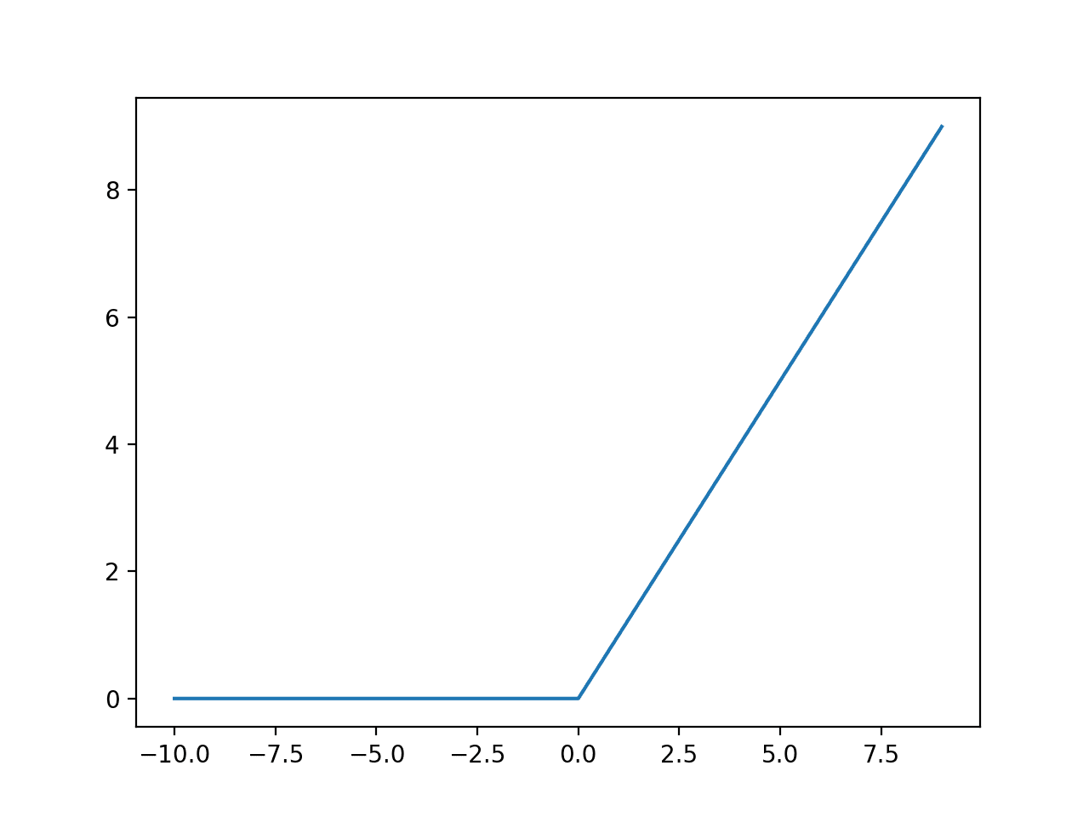
What is an Activation Function?
Rectified Linear Unit (RELU) Function
Without getting into the math:
Activation layers allow non-linearity to be introduced allowing neural networks to learn complex, non linear patterns
The ReLU function is the standard in deep learning
f(x)=max(0,x)
Very computationally efficient
Leads to sparse network
Solves the “vanishing gradient” problem

Slide 21
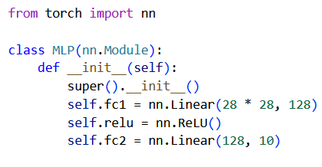
NN Instantiation
01
In the init() function you will define two fully connected layers and the ReLU activation function:
An input layer for the image 784 (28*28) pixels -> hidden layer of 128 nodes
Hidden layer of
128 nodes -> Output layer of 10 classifications (0-9)

Slide 22
Neural Network Steps
01
Setting up the NN
In our NN class we need to define two functions:
init(self) - What is the neural network created with -> Define the layers
forward(self, x) - The process of the data being passed through the neural network
02
Loss and Optimizer
03
Training the Model

Slide 23
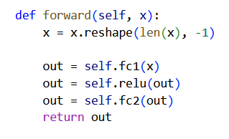
Forward Pass
How our tensor will be passed through the NN.
The image as a tensor is still two-dimensional (still in the shape of a grid)
We need to make it one dimensional so each pixel is assigned to a neuron
PyTorch provides:
x = x.reshape(len(x), -1)
Otherwise, the data is passed into the first layer -> activation function -> second layer

Slide 24
Neural Network Steps
01
Setting up the NN
02
Loss and Optimizer
The loss measures how wrong the model's predictions are, while the optimizer adjusts the model's weights to reduce that wrongness
03
Training the Model

Slide 25
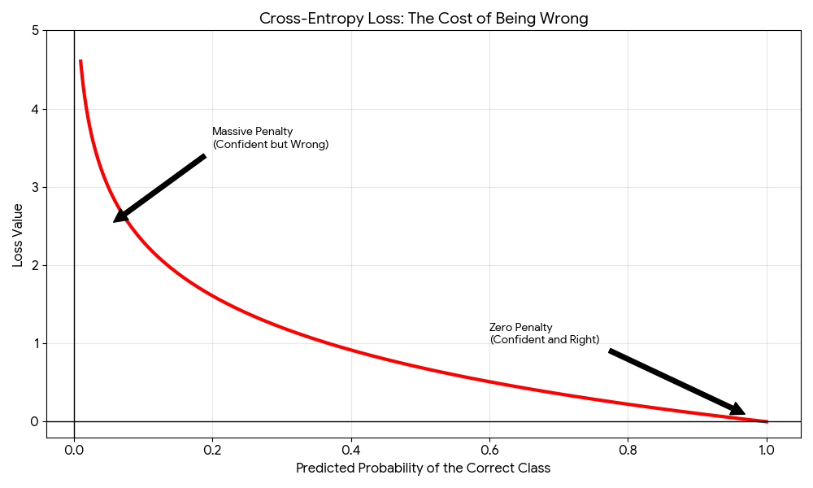
Cross-Entropy Loss
To calculate loss you get the predictions from the model and run it through the loss function.
For classification Cross-Entropy loss is used.

Slide 26
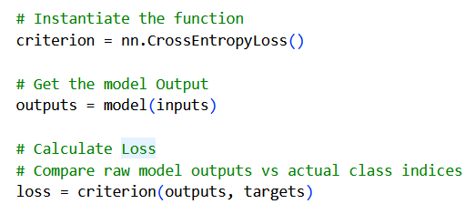
Cross-Entropy Loss

Slide 27
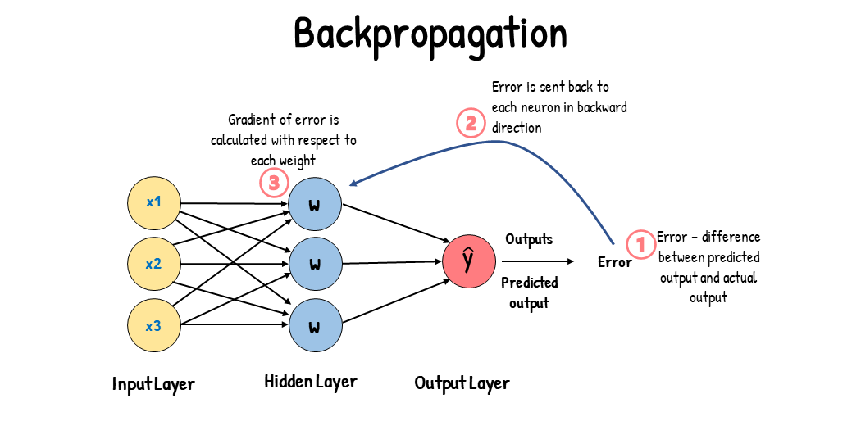
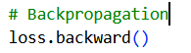
Backpropagation
The Blame Game:
It assigns a specific portion of the total error to every single connection in the network.

Slide 28
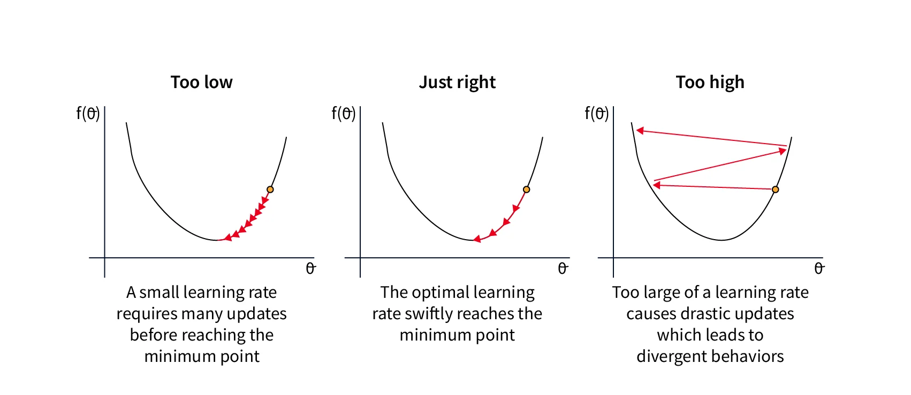
Optimizer
The optimizer is responsible for using the Loss and Backpropagation to update the weight
The Learning Rate is the most critical component

Slide 29
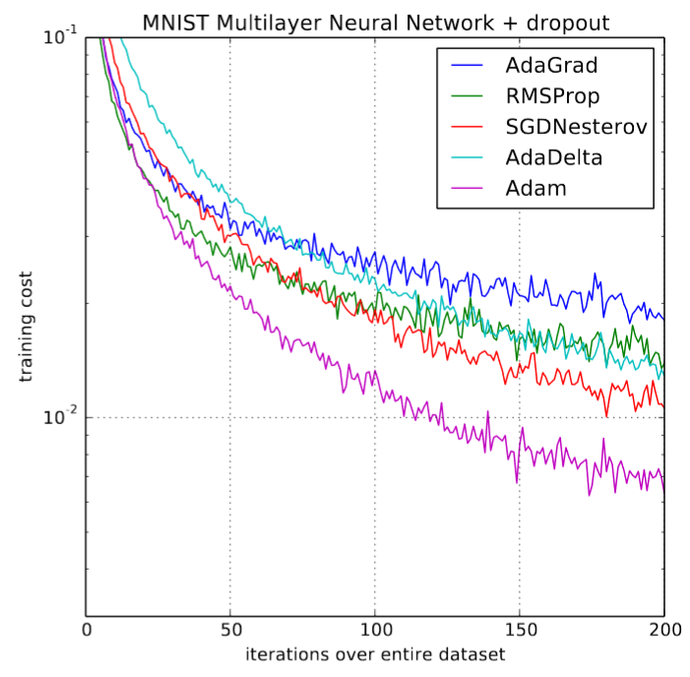
Optimizer
Adaptive Moment Estimation (ADAM) is what we will use for this tutorial and commonly used in the field due to it’s
Adaptive Learning Rates

Slide 30
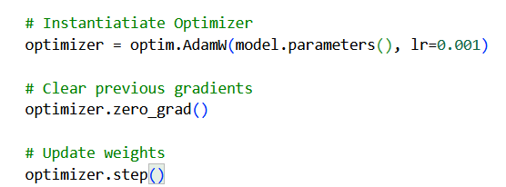
Optimizer

Slide 31
Neural Network Steps
01
Setting up the NN
02
Loss and Optimizer
03
Training the Model
An epoch is one complete pass through the entire dataset

Slide 32
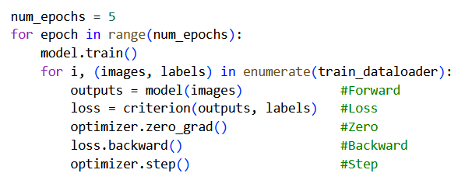
Training Loop
Step 1
Determine amount of epochs
For every epoch set the model to training mode
-> model.train()
For every image and associated label in data loader
-> for i, (images, labels) in enumerate(train_dataloader):
STEP 2
Get predictions
Calculate loss
Zero past gradients
Calculate new gradients
Update weights

Slide 33
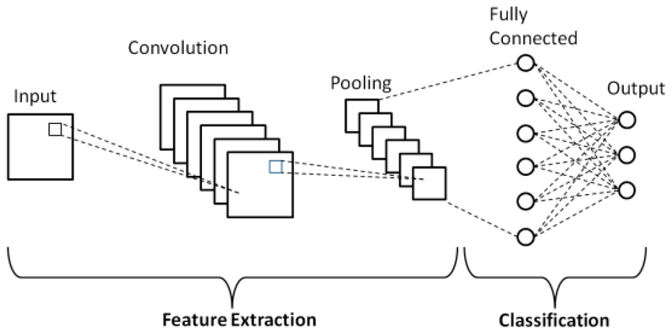
Convolutional Neural Networks (CNNs)

Slide 34
Convolution: Why CNNs?
CNNs don’t have nearly as many weights to train making them quicker to train
CNNs take into account the spatial structure of the image (allowing us to preserve data)
Hence, less computationally intensive and often more accurate than MLP

Slide 35
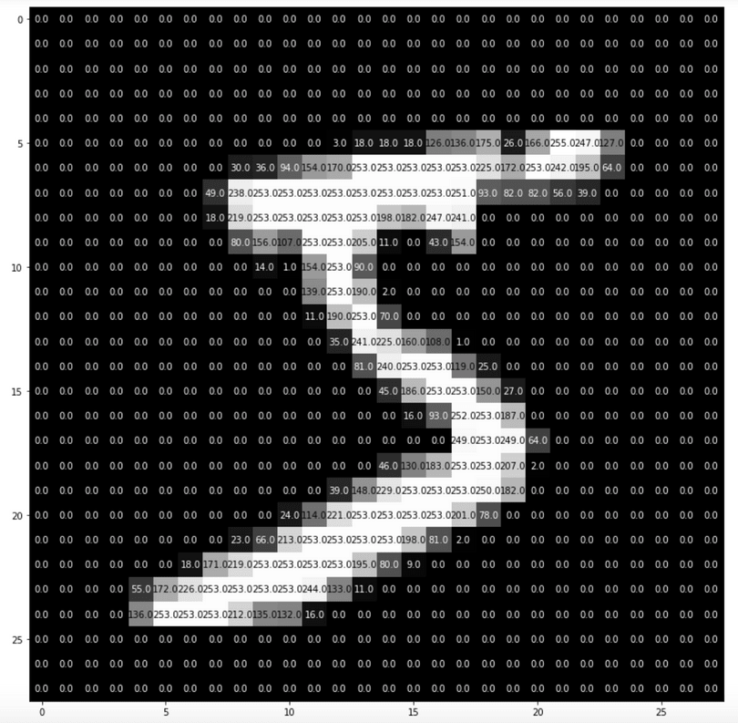
Convolution:
Representing Images
Since NNs neglect the structure of the image, let’s look at the image
What do you see?

Slide 36
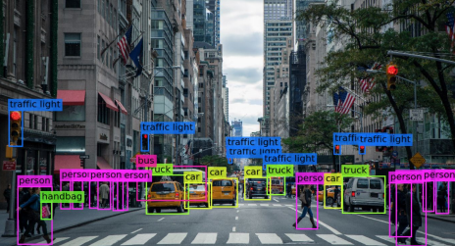
Convolution: What is a CNN?
Images are represented as a matrix and are viewed in sections
These sections are called patches which are treated individually
We isolate features/patterns of an image using a filter (aka kernel)
Works best for image recognition

Slide 37
Convolution: What is a kernel?
-1 | 0 | 1
-1 | 0 | 1
-1 | 0 | 1
A kernel is a filter used to identify patterns within data
Each kernel corresponds to a unique pattern
It is represented by a matrix
We identify how close each patch fits the pattern using activation
Activation is represented by a number and identifies if the pattern we are searching for is present

Slide 38
Convolution: Activation
The top image is a 3x3 patch of the image
The bottom image is our kernel
We can calculate the activation by computing the dot product between the kernel and the patch
For the highest activation:
Positive kernel values lie on top of bright pixels
Negative kernel values lie on top dark pixels
Kernel values of 0 are negligible
-1 | 0 | 1
-1 | 0 | 1
-1 | 0 | 1

Slide 39
Convolution: Activation
-1 | 0 | 1
-1 | 0 | 1
-1 | 0 | 1
The top image is a 3x3 patch of the image
The bottom image is our kernel
We can calculate the activation by computing the dot product between the kernel and the patch
For the highest activation:
Positive kernel values lie on top of bright pixels
Negative kernel values lie on top dark pixels
Kernel values of 0 are negligible

Slide 40
Convolution: Matrix Multiplication
Computing the activation:
A = (-1) x 0 + (0) x 49 + 238 x (1) + (-1) x 0 + (0) x 18 + 219 x (1) + (-1) x 0 + (0) x 0 + 80 x (1)
A = 537
The activation for the 3x3 image for this kernel is 537.
-1 | 0 | 1
-1 | 0 | 1
-1 | 0 | 1

Slide 41
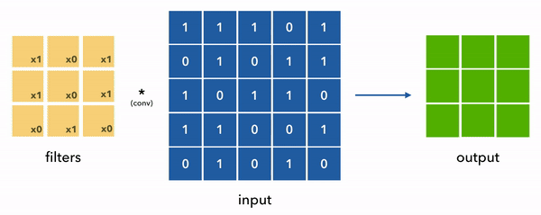
Convolution
For each iteration, the activation of the image is written into the kernel’s feature map
We continue doing this until we reach the end of the image patch, this is one convolution
Below is an example of convolution with a stride of 1 (stride is the number of pixels the kernel moves on each convolution

Slide 42
Feature Mapping: What is it?
Once we have completed our convolution we are left with the feature map of the kernel
The feature map represents where the feature is detected, it is represented by a matrix
Question: What will the dimensions of our feature map be after iterating a 3x3 kernel with stride 1 over a 28x28 image?

Slide 43
Feature Mapping: What is it?
Once we have completed our convolution we are left with the feature map of the kernel
The feature map represents where the feature is detected, it is represented by a matrix
Question: What will the dimensions of our feature map be after iterating a 3x3 kernel with stride 1 over a 28x28 image?
Answer: 26x26

Slide 44
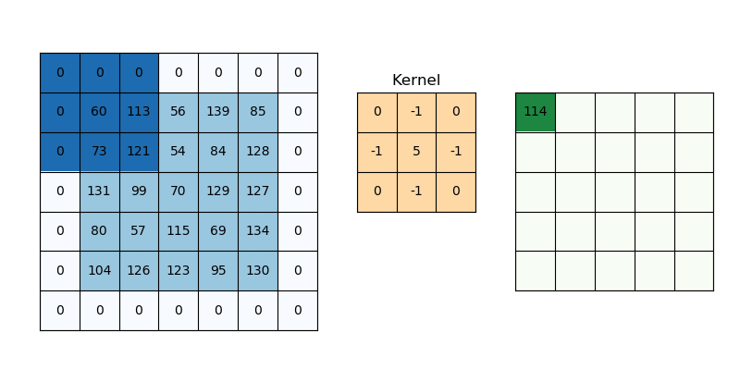
Feature Mapping: Padding
Padding allows us to preserve the size of the image by adding a 1 pixel border of zeroes
This will allow us to have a feature map the same size as the original patch

Slide 45
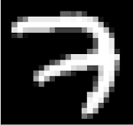
Feature Mapping: Visualization
0 | 1 | -1
0 | 1 | -1
0 | 1 | -1
∅
∅
∅
This filter looks for a change in brightness from light to dark when moving from left to right
Question: Where might we see high activation of this filter on the image on the right?

Slide 46
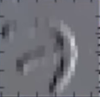
Feature Mapping: Visualization
0 | 1 | -1
0 | 1 | -1
0 | 1 | -1
∅
∅
∅
This filter looks for a change in brightness from bright to dark when moving from left to right
Answer:

Slide 47
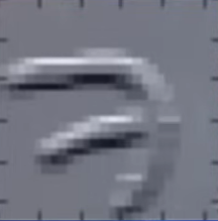
Feature Mapping: Visualization
Question:
Given the following feature map can anyone tell me the 3x3 kernel that corresponds to this feature map?

Slide 48
Feature Mapping: Visualization
Question:
Given the following feature map can anyone tell me the 3x3 kernel that corresponds to this feature map?
Answer:
-1 | ∅
∅ | ∅ | ∅
-1 | -1 | -1
1 | 1 | 1
0 | 0 | 0

Slide 49
Building: Layers
In the MLP you only saw the fully connected layer aka linear layer (which combined the features learned through neurons and used it to classify the images)
CNNs introduce two different types of layers:
A convolutional layer which detects patterns using filters
A pooling layer which uses an empty filter on the feature map and applies a function to the selected area (i.e. mean or max)
Pooling does NOT involve any dot product sums
Pooling is done to ensure we are not overfitting the model

Slide 50
Building: Pooling
4 | 7 | 9 | 9
6 | 7 | 1 | 9
2 | 2 | 3 | 8
1 | 3 | 5 | 4
Note: We a stride of 2 is used so we can create 2x2 pooling windows
Average Pooling
6 | 7
2 | 5
With a 2x2 filter
And stride of 2
4 | 7 | 9 | 9
6 | 7 | 1 | 9
2 | 2 | 3 | 8
1 | 3 | 5 | 4
Max Pooling
7 | 9
3 | 8
With a 2x2 filter
And stride of 2

Slide 51
Building: Model Architecture
Define a class ensure that you inherit from nn.Module, create a constructor, call the constructor of the parent class
Create a convolutional layer (# of input channels, # of output channels(aka # of filters), kernel_size=x, stride=y, padding=z)
Use ReLU function (removes noise and speeds up the training process)
Create a pooling layer to avoid overfitting (kernel_size=x, stride=y)

Slide 52
Building: Model Architecture
Create another convolutional layer (# of input channels(same as the number of output channels in the previous layer), # of output channels(aka # of filters), kernel_size=x, stride=y, padding=z)
Use ReLU function (removes noise and speeds up the training process)
Create a pooling layer to avoid overfitting (kernel_size=x, stride=y)
Flatten your feature maps into a 1D vector (to pass to the fully connected layer)
Create a linear layer with 10 outputs (0-9) to classify the data

Slide 53
Training: Forward Pass
Create a forward pass function
Apply all the layers you created in your constructor to the object
Convolution (scan image to detect patterns and create feature map)
ReLU (Removes negative values introducing non-linearity)
Pooling (shrinks the feature map making the model more resilient to small changes)
Convolution, ReLU, Pooling again
Flatten (Flattens the feature maps created into a 1D vector)
Linear layer (outputs 10 numbers, the largest one corresponds to the models prediction)

Slide 54
Training: Results
MLP had ~101,000 parameters and achieved a 95% accuracy.
CNN has ~16,000 parameters and achieved a 97% accuracy.
Why is this important?
Instead of having so many fully connected layers of neurons where each neuron has a corresponding weight, a 3x3 kernel is reused many times per convolution saving on computation power

Slide 55
Convolutional Neural Network Conclusion
CNNs use local pattern detectors to recognize patterns
Feature maps help us identify what the pattern detectors see
Each convolution = local pattern detectors
CNNs are more efficient and more accurate for image recognition because of their ability to reuse the kernel and preserve image structure

Slide 56
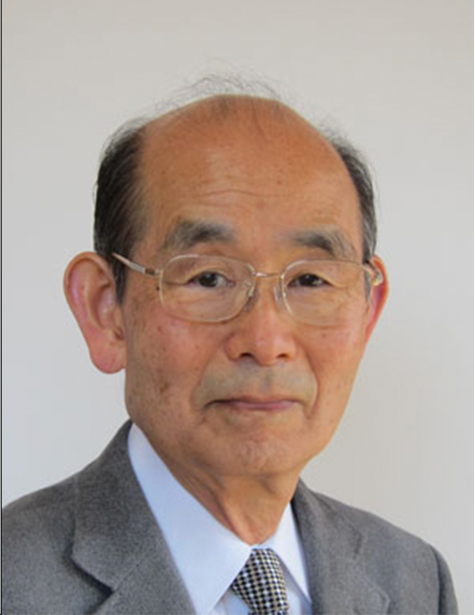


History
The initial framework for the modern CNN came from Kunihiko Fukushima
LeCun added backpropogation and labelled data end to end moving to supervised learning
In 2012, AlexNet maximized the use of GPUs to make deeper models and added ReLU and other functions to ensure the model doesn’t overfit
Kunihiko Fukushima
Yann LeCun

Slide 57
Conclusion
We have gone through 3 generations of Neural Networks
Perceptron -> Multi-Layer Perceptron -> Convolutional Neural Network
You’ve trained your own model to identify the difference between 6 and 7

